Slide 1
Chapter 3
Random Variables and Probability Distributions

Slide 2
Section 3.1
Concept of a Random Variable

Slide 3
Definition 3.1
Copyright © 2017 Pearson Education, Ltd. All rights reserved.
3 - <number>

Slide 4
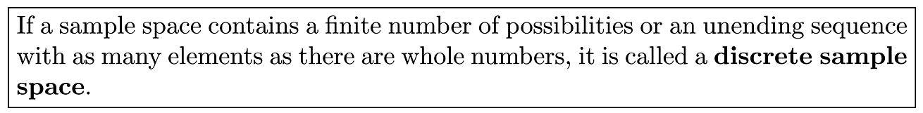
Definition 3.2
Copyright © 2017 Pearson Education, Ltd. All rights reserved.
3 - <number>

Slide 5
Definition 3.3
Copyright © 2017 Pearson Education, Ltd. All rights reserved.
3 - <number>

Slide 6
Section 3.2
Discrete Probability Distribution

Slide 7
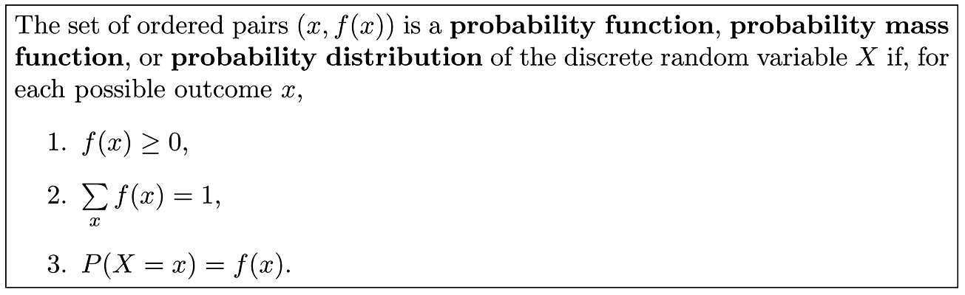
Definition 3.4
Copyright © 2017 Pearson Education, Ltd. All rights reserved.
3 - <number>

Slide 8
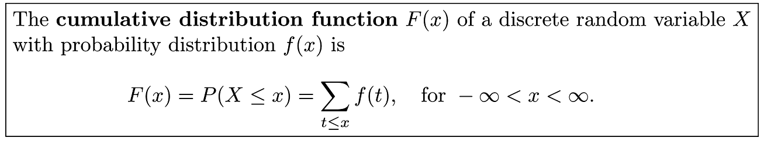
Definition 3.5
Copyright © 2017 Pearson Education, Ltd. All rights reserved.
3 - <number>

Slide 9
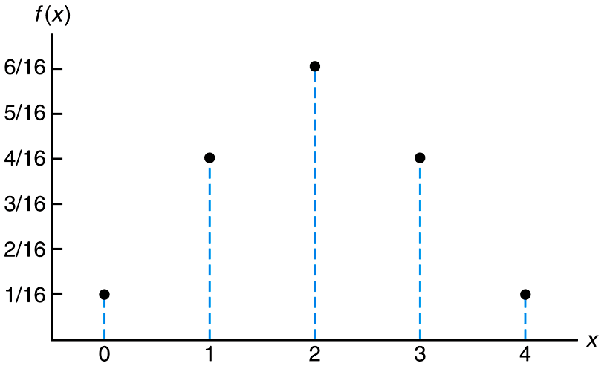
Figure 3.1 Probability mass function plot
Copyright © 2017 Pearson Education, Ltd. All rights reserved.
3 - <number>

Slide 10
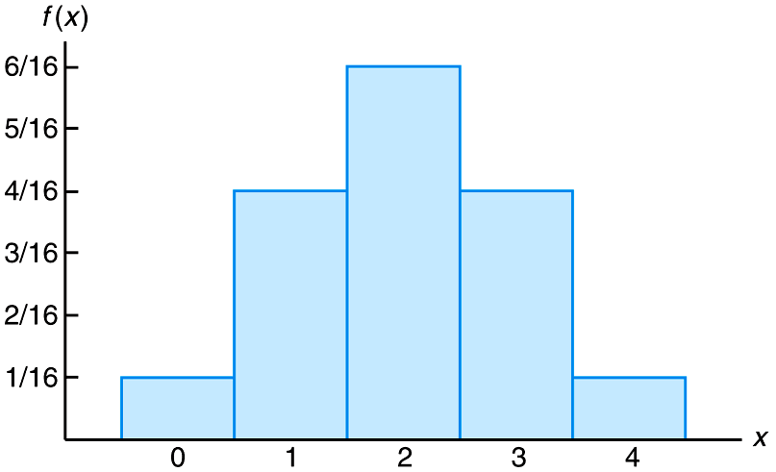
Figure 3.2 Probability histogram
Copyright © 2017 Pearson Education, Ltd. All rights reserved.
3 - <number>

Slide 11
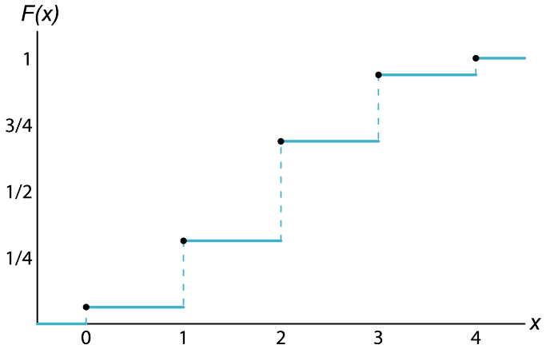
Figure 3.3 Discrete cumulative distribution function
Copyright © 2017 Pearson Education, Ltd. All rights reserved.
3 - <number>

Slide 12
Section 3.3
Continuous Probability Distributions

Slide 13
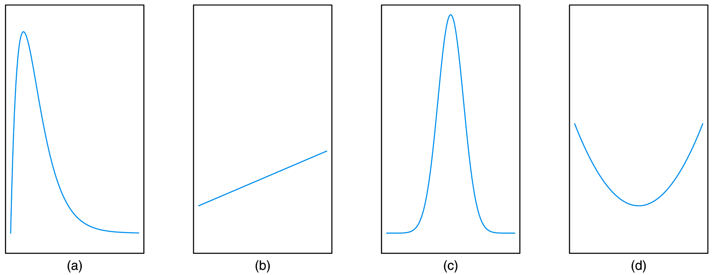
Figure 3.4 Typical density functions
Copyright © 2017 Pearson Education, Ltd. All rights reserved.
3 - <number>

Slide 14
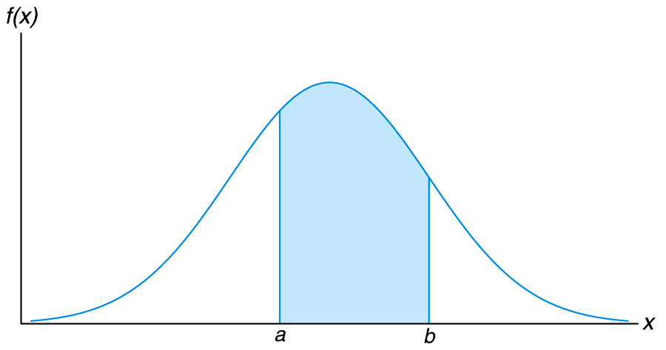
Figure 3.5 P(a < X < b)
Copyright © 2017 Pearson Education, Ltd. All rights reserved.
3 - <number>

Slide 15
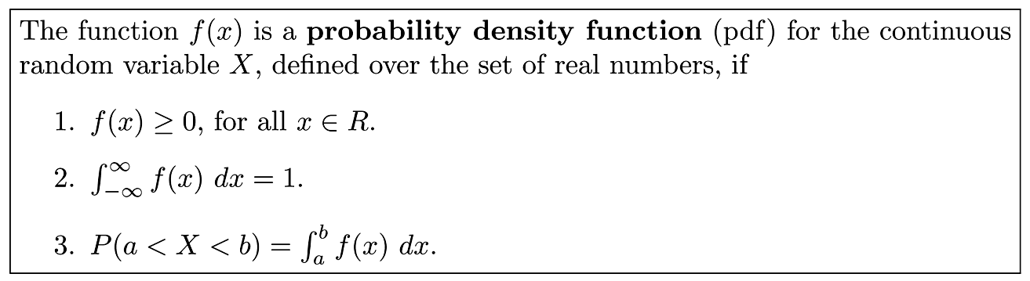
Definition 3.6
Copyright © 2017 Pearson Education, Ltd. All rights reserved.
3 - <number>

Slide 16
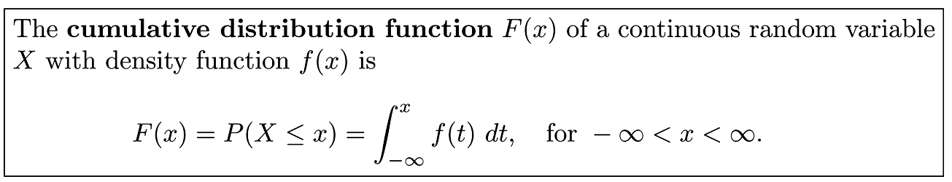
Definition 3.7
Copyright © 2017 Pearson Education, Ltd. All rights reserved.
3 - <number>

Slide 17
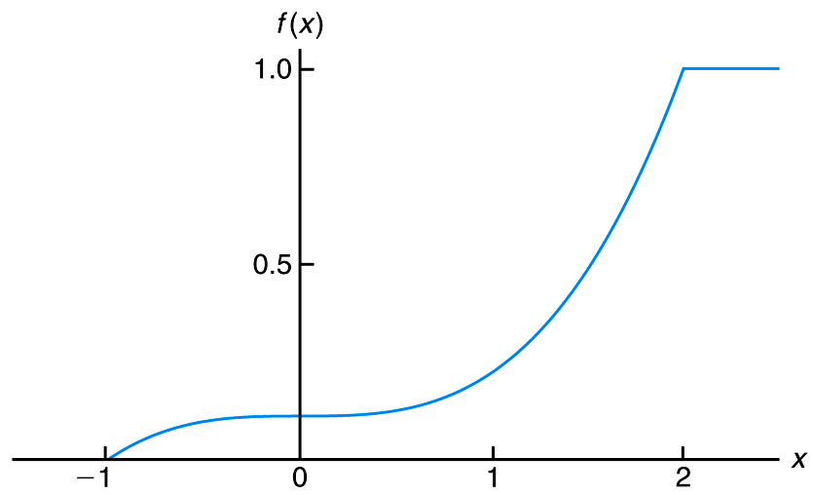
Figure 3.6 Continuous cumulative distribution function
Copyright © 2017 Pearson Education, Ltd. All rights reserved.
3 - <number>

Slide 18
Section 3.4
Joint Probability Distributions

Slide 19
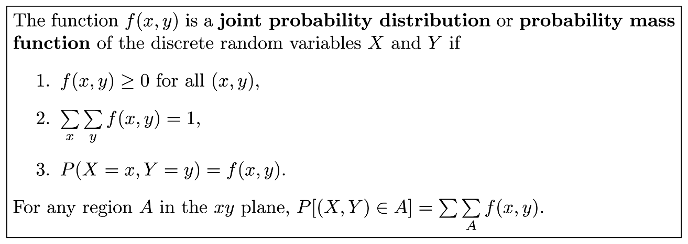
Definition 3.8
Copyright © 2017 Pearson Education, Ltd. All rights reserved.
3 - <number>

Slide 20
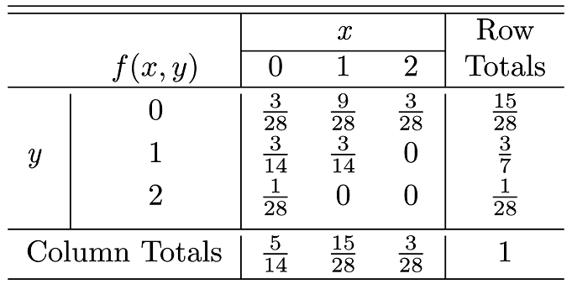
Table 3.1 Joint Probability Distribution for Example 3.14
Copyright © 2017 Pearson Education, Ltd. All rights reserved.
3 - <number>

Slide 21
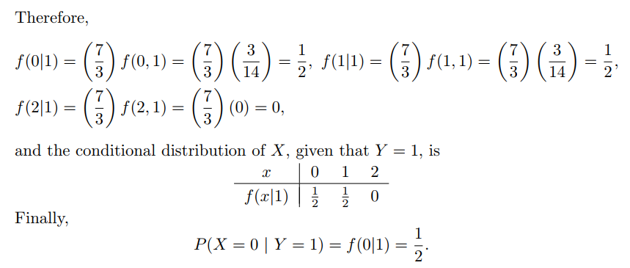
Conditional Probability
Copyright © 2017 Pearson Education, Ltd. All rights reserved.
3 - <number>

Slide 22
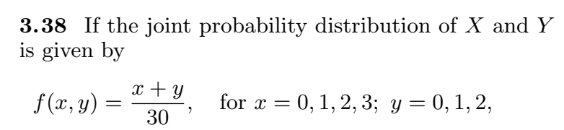
Copyright © 2017 Pearson Education, Ltd. All rights reserved.
3 - <number>

Slide 23
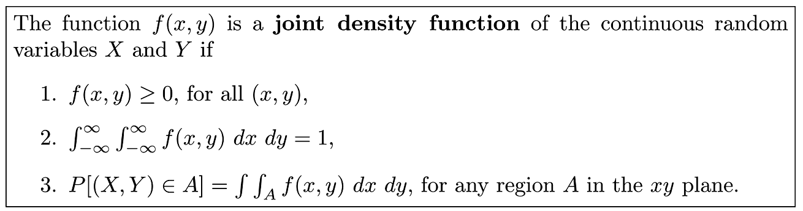
Definition 3.9
Copyright © 2017 Pearson Education, Ltd. All rights reserved.
3 - <number>

Slide 24
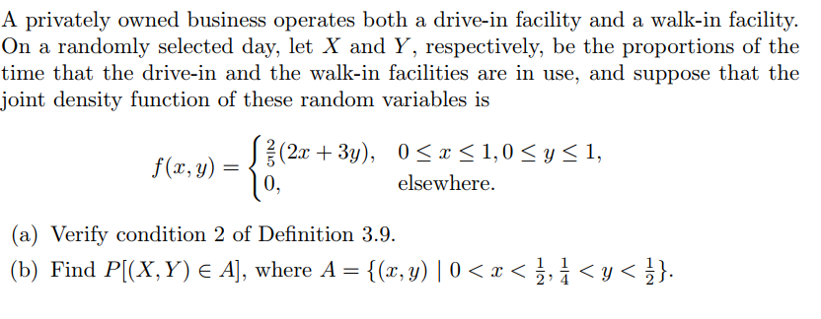
Copyright © 2017 Pearson Education, Ltd. All rights reserved.
3 - <number>

Slide 25
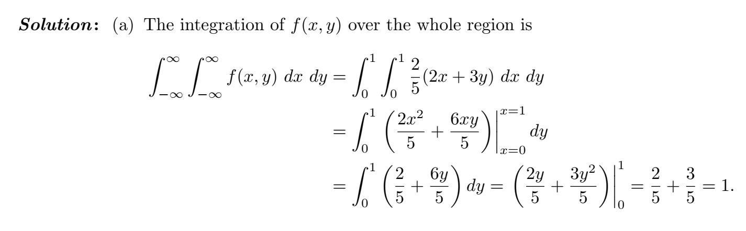
Copyright © 2017 Pearson Education, Ltd. All rights reserved.
3 - <number>

Slide 26
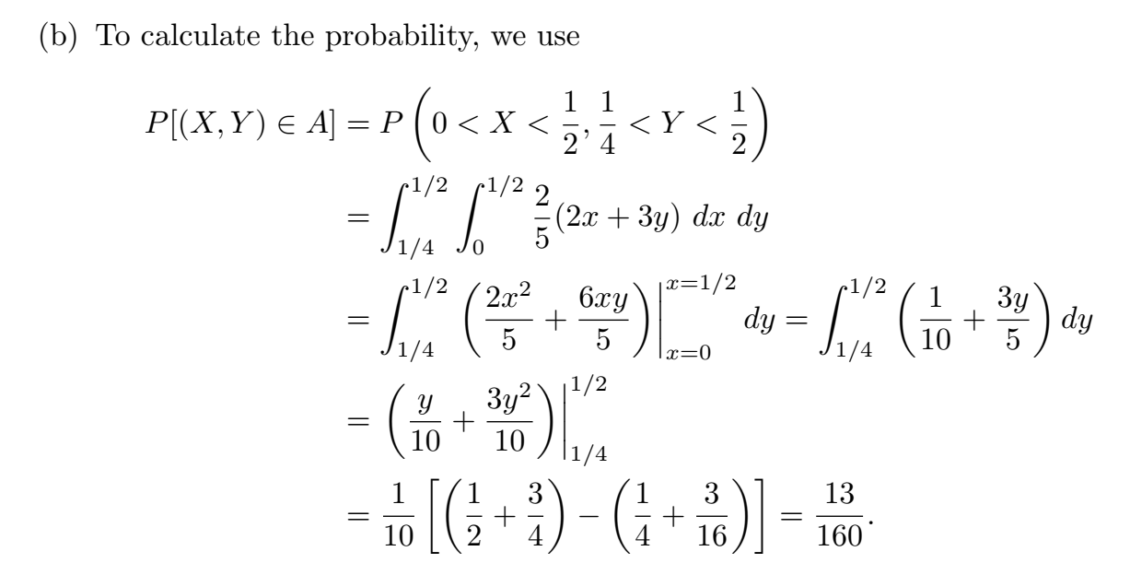
Copyright © 2017 Pearson Education, Ltd. All rights reserved.
3 - <number>

Slide 27
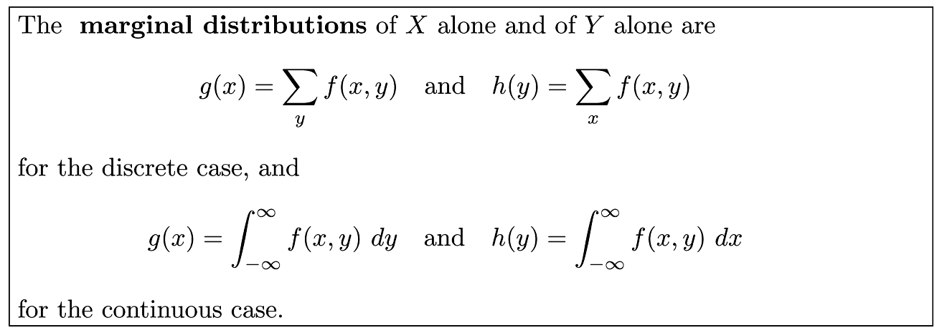
Definition 3.10
Copyright © 2017 Pearson Education, Ltd. All rights reserved.
3 - <number>

Slide 28
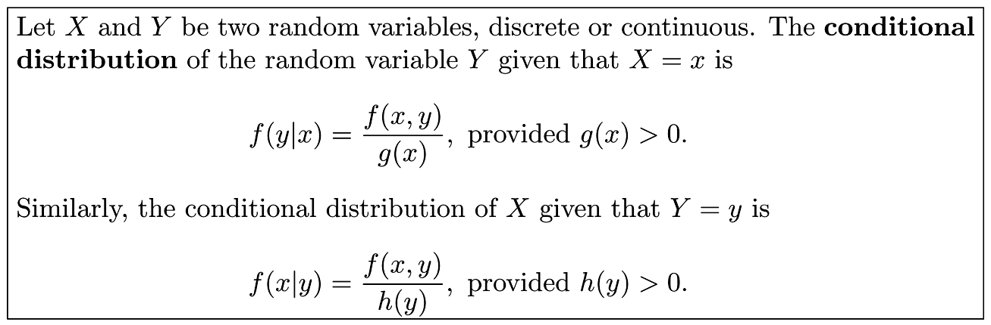
Definition 3.11
Copyright © 2017 Pearson Education, Ltd. All rights reserved.
3 - <number>

Slide 29
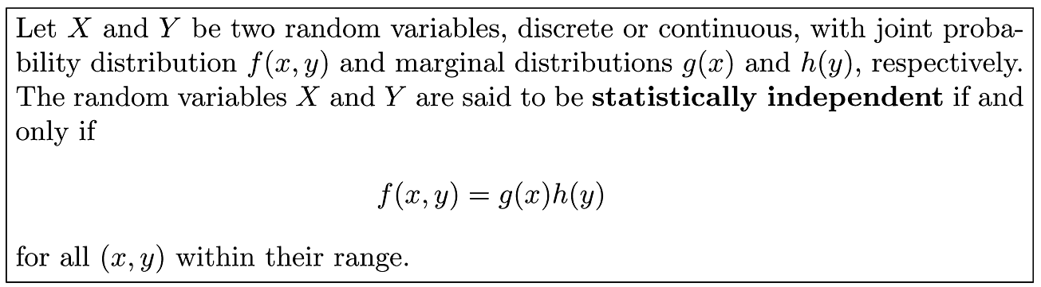
Definition 3.12
Copyright © 2017 Pearson Education, Ltd. All rights reserved.
3 - <number>

Slide 30
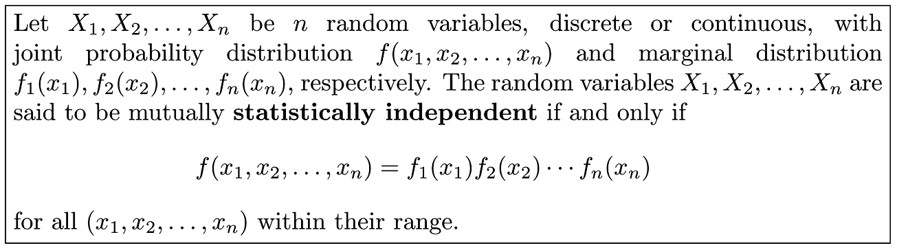
Definition 3.13
Copyright © 2017 Pearson Education, Ltd. All rights reserved.
3 - <number>

Slide 31
Section 3.5
Potential Misconceptions and Hazards; Relationship to Material in Other Chapters

